Slide 1

WorkFlow-CRM: A Multi-Tenant Customer Relationship & Workflow Management System for Service & Repair Shops
CSA1553 - Cloud Computing & Big Data Analytics Using NAS
Presented By:
B RUTHESH (192521465)
Supervised By
Dr.Anuradha

Slide 2


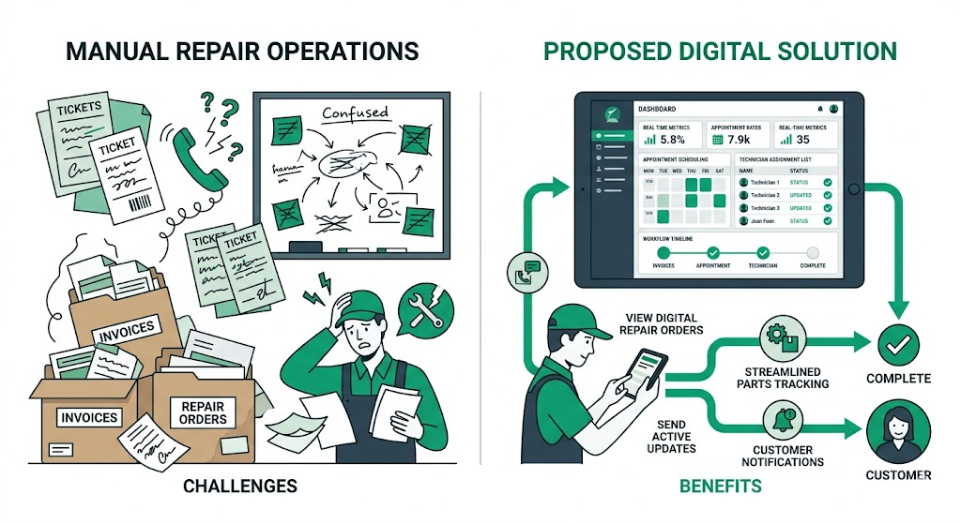
INTRODUCTION
The Operational Problem: Traditional service/repair shops struggle with highly fragmented customer tickets, a lack of real-time repair tracking, and offline, uncontrolled parts purchasing.
The Unified Solution: WorkFlow-CRM acts as a central cloud platform, seamlessly linking client ticketing, engineering workflows, and procurement operations.
Modern Technical Paradigm: Employs a blazing-fast serverless architecture featuring React 18, TypeScript, Tailwind CSS, Radix UI, and Firebase for responsive, real-time collaboration.
Target Audience: Multi-branch electronics service centers, mechanical repair workshops, and medium-sized enterprise maintenance departments.

Slide 3
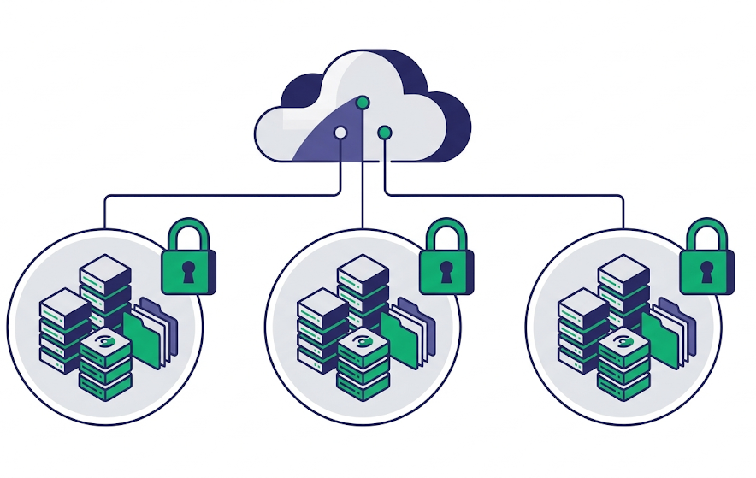
PROJECT OVERVIEW
Logical Multi-Tenant Isolation: Provides robust SaaS capabilities where each shop operates within its own secured database instance, preventing cross-tenant data visibility.
End-to-End Task Orchestration: Automates the repair lifecycle from client intake and ticket creation, to technician dispatch, parts requests, and final delivery.
Persona-Driven Dashboards: Connects four customized user roles (Owner, Admin, Engineer, Purchase Manager) with UI elements tailored to their exact daily workflows.
Zero-Refresh Synchronization: Built on Firestore real-time listeners (onSnapshot) so all staff members get instant updates without manual browser reloads.

Slide 4
OBJECTIVES
Accelerate Repair Cycles: Streamline ticket assignment and technician handover to dramatically reduce average repair turnaround times.
Enforce Procurement Transparency: Implement a strict, multi-tier approval system for replacement parts to track estimated vs. actual expenses and prevent unauthorized purchases.
Establish SaaS Security Controls: Enforce bulletproof multi-tenant separation using declarative Firestore Security Rules and custom client-side navigation filters.
Enable Actionable Operations Management: Empower owners with real-time KPI counters, interactive Recharts visualization, and an immutable system activity log.

Slide 5
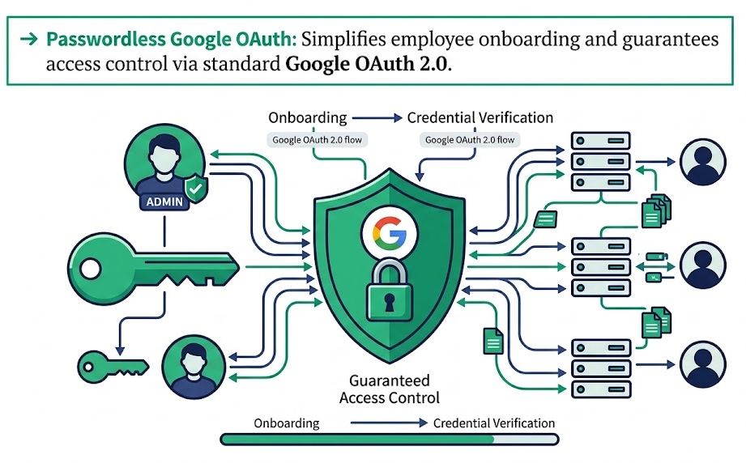
MODULE 1: MULTI-TENANT SHOP MANAGEMENT & AUTHENTICATION
Passwordless Google OAuth: Simplifies employee onboarding and guarantees access control via standard Google OAuth 2.0.
Logical Shop Provisioning: Allows shop owners to instantly initialize virtual shops and configure custom names, operational settings, and employee groups.
Onboarding Queue: Automatically places new employee registrations in a pending state, redirecting them to a secure "Waiting for Approval" screen until active authorization is granted.
Tenant Data Separation: Isolates all records (tickets, logs, purchases) within Firestore using strict path routing keys keyed under /shops/{shopId}.

Slide 6
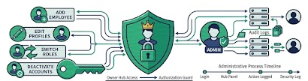
MODULE 2: ROLE-BASED ACCESS CONTROL (RBAC) & USER MANAGEMENT
Four-Tiered Permission Matrix: Features fine-grained control for Owner (full system access), Admin (ticketing & assignment), Engineer (repair status & part requests), and Purchase Manager (order logistics).
Owner Administration Hub: A centralized panel allowing owners to add employees, edit profiles, switch roles, deactivate accounts, and audit logs.
Dynamic Nav Filtering: Renders client-side routes and mobile navigation bottom-tabs on the fly, showing only the tabs accessible to the logged-in user's role.
Double-Layer Access Validation: Protects endpoints using client-side router guards in React and server-side constraints via Firestore database-level security rules.

Slide 7
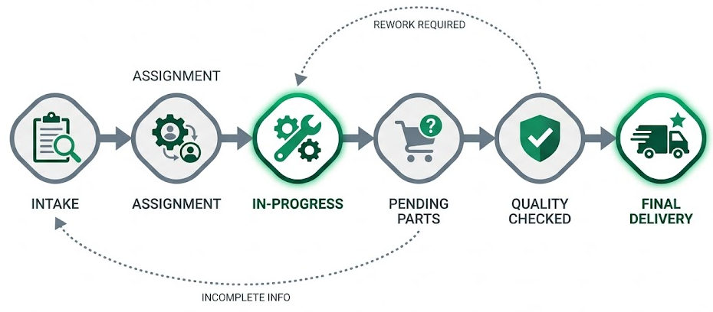
MODULE 3: TICKET LIFECYCLE & WORKFLOW ENGINE
Consecutive Ticket Generation: Employs synchronized database counters in transaction-safe calls to generate unique, sequential ticket IDs (e.g., DS1000, DS1001).
Workflow Engine Enforcement: Implements a strict status transition workflow
(e.g., pending_assignment ➔ assigned ➔ in_progress ➔ purchase_await ➔ ready ➔ delivered).
Rich Diagnostic Fields: Captures hardware specifications (Model, Brand, Components), customer details, issues, delivery schedules, and financials (Charged, Paid, Balance Due).
Exception Handlers: Built-in statuses for operational edge cases like customer_hold (with a calendar date picker) and return (to send a delivered device back to rework).

Slide 8
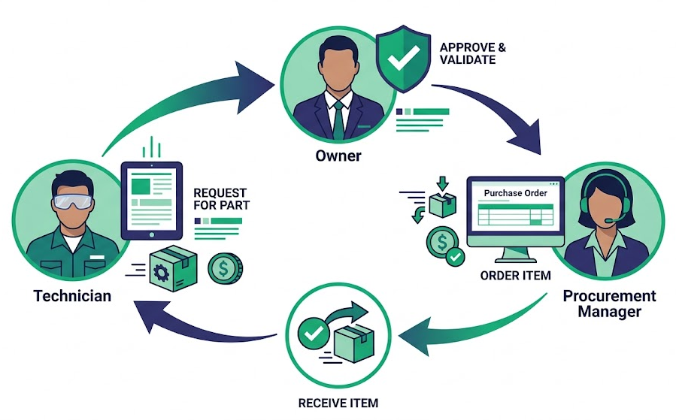
MODULE 4: INTEGRATED PARTS PROCUREMENT & PURCHASE WORKFLOW
Technician-Initiated Requests: Enables engineers to instantly request specific parts directly from their active ticket card, detailing names, quantities, and cost estimates.
Owner Approval Loop: Features an owner dashboard where requests are reviewed, then either approved (moving status to initiated for the mediator) or rejected with audit reasons.
Dedicated Procurement Dashboard: Provides Purchase Managers with a focused workflow to coordinate with suppliers, log actual purchase prices, and set delivery statuses.
Cost Difference Tracking: Automatically computes actual vs. estimated cost differentials to provide clean, actionable financial tracking for parts procurement.

Slide 9
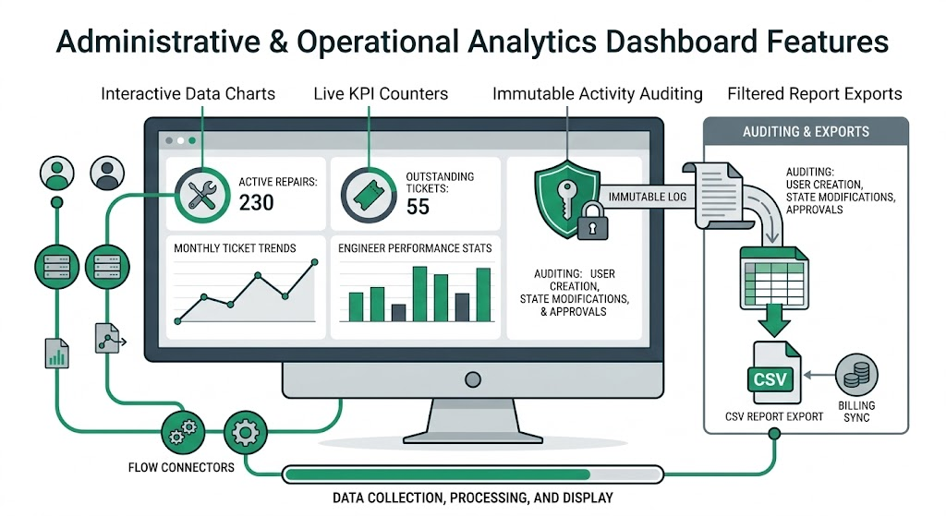
MODULE 5: REAL-TIME ANALYTICS, ACTIVITY LOGGING & REPORT EXPORT
Live KPI Counters: Tracks active repairs, pending approvals, completed orders, and outstanding ticket counts instantly on the dashboard.
Interactive Data Charts: Embeds Recharts graphs (lines and bar charts) to display monthly ticket trends, brand analytics, and engineer performance stats.
Immutable Activity Auditing: Automatically logs a permanent trail of all crucial actions (user creation, ticket state modifications, approvals) containing author names and timestamps.
Filtered Report Exports: Provides tools to export filtered ticket records into standard CSV files, supporting custom date ranges and billing sync.

Slide 10
METHODOLOGY
Agile Software Architecture: Utilized iterative sprint cycles, starting with clean user journeys and mobile layouts, followed by component abstraction and database integration.
Serverless First Principle: Utilized a lightweight, responsive serverless framework, binding client interfaces directly to Firebase databases without middleware latency.
Component-Driven Strategy: Crafted modular, reusable components using Radix UI (dialogs, dropdowns, alerts) and styled dynamically via Tailwind utility classes.
Reactive State Architecture: Implemented React Context API alongside Firestore real-time listeners, minimizing local state discrepancies across components.

Slide 11
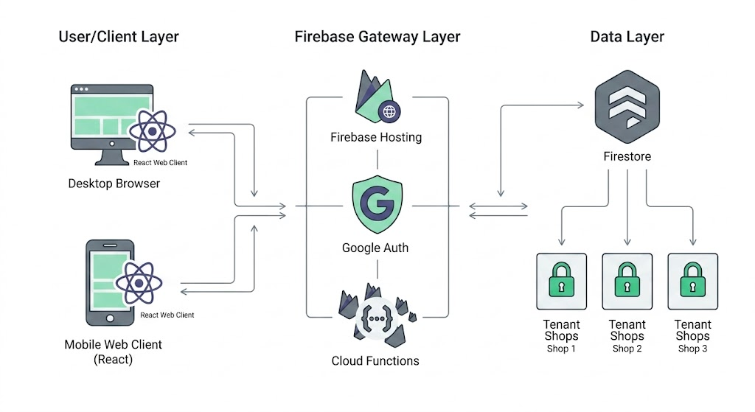
SYSTEM DESIGN / ARCHITECTURE

Slide 12
IMPLEMENTATION
Type-Safe Ecosystem: Constructed using React 18, Vite (for blazing fast builds), and strict TypeScript definitions to prevent runtime failures.
Transaction Safeguards: Prevented concurrent ticket creation collisions by using Firestore Transactions to secure consecutive ticket ID generation.
Logical Database Boundaries: Designed a nested collection structure /shops/{shopId}/tickets/... to enforce intuitive multi-tenant separation.
Robust Firestore Security Rules: Written declarative Firestore rules restricting data reads, writes, and updates based on authenticated user IDs and verified roles.

Slide 13
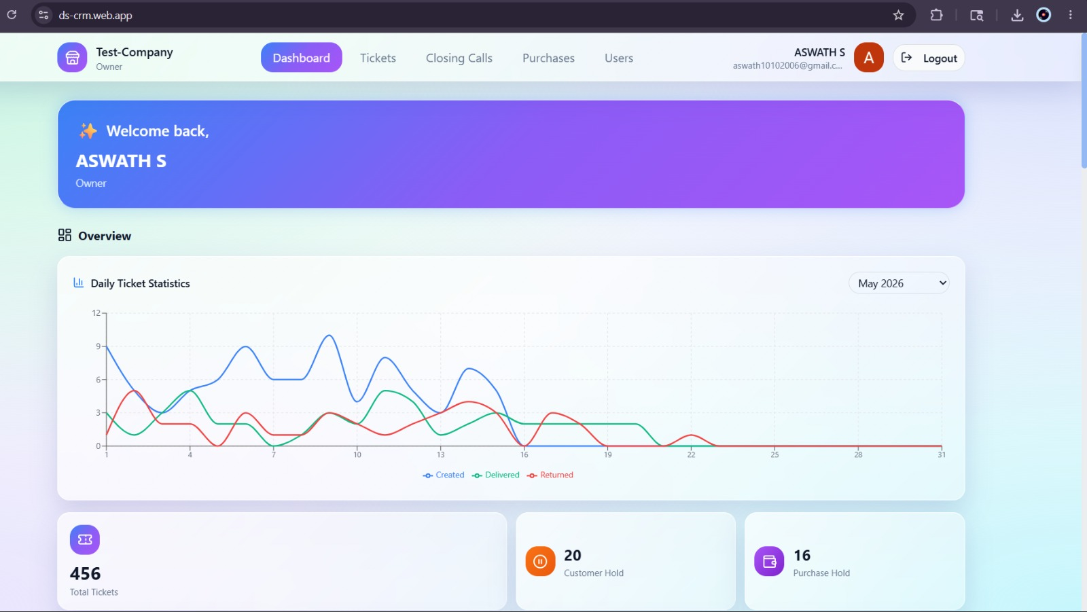
RESULTS AND DISCUSSION
Sub-Second Collaboration: Achieved instantaneous, zero-delay communication between administrative offices, workbench technicians, and procurement staff.
Accelerated Ticket Completion: Decreased the average repair cycle length by automating handoffs and part requests directly from ticket interfaces.
Enhanced Cost Controls: Eradicated shadow-spending on parts by routing all purchases through the Owner Approval and Purchase Manager tracking loop.
High Mobile Usability: Provided technicians with an intuitive mobile UI, allowing them to instantly update job statuses and request parts from their mobile devices on the go.

Slide 14
FUTURE SCOPE & CONCLUSION
Automated Customer Channels: Integrating SMS, Email, and WhatsApp APIs to instantly notify customers of status updates (e.g., when a device is "Ready for Delivery").
Dedicated Native Mobile Apps: Developing React Native applications featuring barcode and QR code scanner integration for fast ticket and parts lookup.
Intelligent Inventory Management: Upgrading procurement with a fully automated stockroom module, low-stock warnings, and barcode tracking.
AI-Assisted Diagnostics: Implementing machine learning models to suggest repair timelines, cost projections, and troubleshooting guides based on historical tickets.

Slide 15
REFERENCES
Al-Subaihin, A. A., & Al-Ahmadi, S. A. (2024). Dynamic Data Isolation and Policy-Based Authorization in Serverless Multi-Tenant Cloud Environments. IEEE Access, 12. DOI: 10.1109/ACCESS.2024.3391823
Zhang, Y., Wang, X., & Chen, J. (2025). State-Machine Constrained Process Automation: Enforcing Deterministic Workflows in Collaborative CRM Platforms. arXiv preprint arXiv:2501.04859.
Kumar, R., & Patel, S. (2025). Digital Transformation of Micro and Small Enterprises: A Multi-Tenant Framework for Localized Service CRM Systems. International Journal of Information Management, 78. DOI: 10.1016/j.ijinfomgt.2024.102845
Gomez, M. L., & Santos, F. R. (2024). Automated Procurement Operations and Decentralized Approval Pipelines in Enterprise Asset Management Systems. IEEE Transactions on Engineering Management, 71. DOI: 10.1109/TEM.2024.3387192
Lin, C., & Zhao, H. (2024). Reactive Cloud Data Listeners: Analyzing Latency and Consistency in Event-Driven NoSQL Architectures. arXiv preprint arXiv:2409.08152.

Slide 16
THANK YOU!

